Slide 1
Memory Hierarchy
Morteza Nikooghadam
Chapter 11

Slide 2
Big Picture: Where are We Now?
The five classic components of a computer
Topics:
  Locality and memory hierarchy
  Simple caching techniques
  Many ways to improve cache performance
Processor
Input
Control
Memory
Datapath
Output
Memory

Slide 3
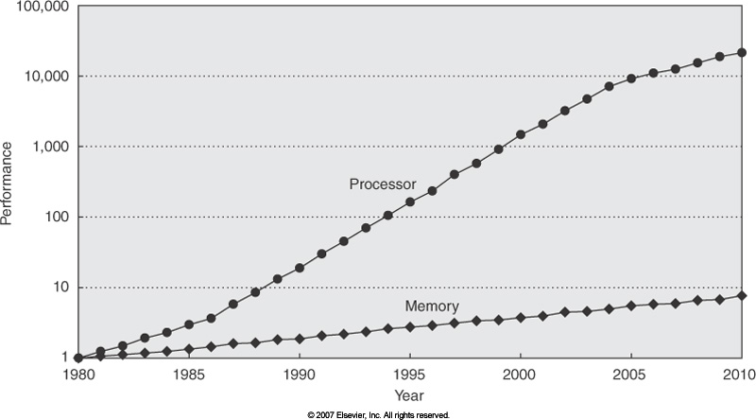
Motivation of Memory Hierarchy
µProc: 60%/yr.
(2X/1.5yr)
“Moore’s Law”
Processor-Memory
Performance Gap:
(grows 50% / year)
Rely on caches to bridge gap
DRAM: 9%/yr.
(2X/10 yrs)
Memory

Slide 4
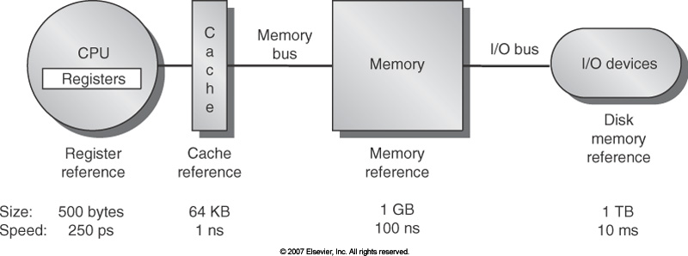
Memory Hierarchy (1/2)
Processor
Control
Memory
Memory
Datapath
Memory
Memory
Memory
Memory

Slide 5
Memory Hierarchy (2/2)
If level closer to processor, it must be:
  Faster
  Smaller
  More expensive
Lowest level (usually disk) contains all available data
  Higher levels have a subset of lower levels (contains most recently used data)
Goal: illusion of large, fast, cheap memory
Memory

Slide 6
Memory Caching
Mismatch between processor and memory speeds leads us to add a new level: a memory cache
Memory hierarchy implementation
  Top levels - SRAM: static random access memory
    Faster but more expensive than DRAM memory
  Main memory - DRAM: dynamic random access memory
  Bottom level - magnetic disks
  Appendix B.8
  arstechnica.com/paedia/r/ram_guide/ram_guide.part1-1.html
Memory

Slide 7
Memory Hierarchy Basis
Disk contains everything
When processor needs something, first search the highest level
  If search fails, bring it from the lower levels of memory
  Cache contains copies of data in memory that are being used
  Memory contains copies of data on disk that are being used
Entire idea is based on temporal locality and spatial locality
  If we use it now, we will want to use it again soon
  If we use it now, we will use those nearby soon
Memory

Slide 8
Memory Hierarchy: Terminology
Hit: data appears in some block in the upper level
  Hit rate: the fraction of memory access found in the upper level
  Hit time: time to access the upper level
    RAM access time + time to determine hit/miss
Miss: data needs to be retrieved from a block in the lower level
  Miss rate = 1 - (hit rate)
  Miss penalty: time to fetch a block into a level of memory hierarchy from the lower level
  Access time on a miss = hit time + miss penalty
Hit time << miss penalty
Memory
Notes:
time to replace a block in the upper level + time to deliver the block to the processor

Slide 9
Cache Design
How do we organize cache?
Where does each memory address map to?
  Remember that cache is a subset of memory, so multiple memory addresses may map to the same cache location
How do we know which elements are in cache?
How do we quickly locate them?
Cache technologies
  Direct-mapped cache
  Fully associative cache
  Set associative cache
Memory

Slide 10
Direct-Mapped Cache (1/2)
In a direct-mapped cache, each memory address is associated with one possible block within the cache
  Therefore, we only need to look in a single location in the cache for the data to check if it exists in the cache
  Block is the unit of transfer between cache and memory
Memory

Slide 11
Direct-Mapped Cache (2/2)
Memory
Address
Cache
Index
4 Word Direct
Mapped Cache
Memory
0
0
1
1
2
2
3
3
4
5
6
7
Mapping:
  (Block address) modulo (no. of blocks in cache)
Cache Location 0 can be occupied by data from:
  Memory location 0, 4, 8, ...
  4 blocks => any memory location that is multiple of 4
8
9
A
B
C
D
E
F
Memory
Notes:
Let’s look at the simplest cache one can build. A direct mapped cache that only has 4 bytes.
In this direct mapped cache with only 4 bytes, location 0 of the cache can be occupied by data form memory location 0, 4, 8, C, ... and so on.
While location 1 of the cache can be occupied by data from memory location 1, 5, 9, ... etc.
So in general, the cache location where a memory location can map to is uniquely determined by the 2 least significant bits of the address (Cache Index).
For example here, any memory location whose two least significant bits of the address are 0s can go to cache location zero.
With so many memory locations to chose from, which one should we place in the cache?
Of course, the one we have read or write most recently because by the principle of temporal locality, the one we just touch is most likely to be the one we will need again soon.
Of all the possible memory locations that can be placed in cache Location 0, how can we tell which one is in the cache?
+2 = 22 min. (Y:02)

Slide 12
Addressing for Direct-Mapped Cache
Since multiple memory addresses map to same cache index, how do we tell which one is in there?
What if we have a block size > 1 word/byte?
  lw, lb
Answer: divide memory address into three fields
ttttttttttttttttt iiiiiiiiii oooo
tag index byte
to check to offset
if have select within
correct block block block
Memory

Slide 13
Direct-Mapped Cache Terminology
All fields are read as unsigned integers
Index: specifies the cache index (which “row” of the cache we should look in)
Offset: once we’ve found correct block, specifies which byte within the block we want
Tag: the remaining bits after offset and index are determined; these are used to distinguish between all the memory addresses that map to the same location
Memory

Slide 14
Direct-Mapped Cache Example
Suppose we have a 16KB of data in a direct-mapped cache with 4 word blocks
Determine the size of the tag, index and offset fields if we’re using a 32-bit architecture
Offset
  Need to specify correct byte within a block
  Block contains 4 words
    = 16 bytes
  Need 4 bits to specify the correct byte
Memory

Slide 15
Direct-Mapped Cache Example
Suppose we have a 16KB of data in a direct-mapped cache with 4 word blocks
Index: (~index into an “array of blocks”)
  Need to specify correct row in cache
  Cache contains 16 KB = 2¹⁴ bytes
  Block contains 16 bytes (4 words)
  # blocks in the cache
    = (bytes/cache) / (bytes/block)
    = (2¹⁴ bytes/cache) / (2⁴ bytes/block)
    = 2¹⁰ blocks/cache
  Need 10 bits to specify this many rows
Memory

Slide 16
Direct-Mapped Cache Example
Tag: use remaining bits as tag
  Tag length = addr length – offset - index
  = 32 - 4 - 10 bits
  = 18 bits
  So tag is leftmost 18 bits of memory address
Memory

Slide 17
Caching Terminology
When we try to read memory, 3 things can happen:
  Cache hit:
  cache block is valid and contains proper address, so read desired word
  Cache miss:
  nothing in cache at the appropriate block, so fetch from memory
  Cache miss, block replacement:
  wrong data is in cache at the appropriate block, so discard it and fetch desired data from memory (cache always copy)
Memory

Slide 18
Accessing Data Example
Memory
Direct-mapped cache, 16KB of data,
4-word blocks
Read 4 addresses
  0x00000014
  0x0000001C
  0x00000034
  0x00008014
Memory values on right:
  Only cache/ memory level of hierarchy
Address (hex)
Value of Word
...
...
00000010
a
00000014
b
00000018
c
0000001C
d
...
...
00000030
e
00000034
f
00000038
g
0000003C
h
...
...
00008010
i
00008014
j
00008018
k
0000801C
l
...
...
Memory

Slide 19
Accessing Data Example
Direct-mapped cache, 16KB of data,
4-word blocks
4 addresses:
  0x00000014, 0x0000001C,
  0x00000034, 0x00008014
4 addresses divided (for convenience) into Tag, Index, Byte Offset fields
000000000000000000 0000000001 0100
000000000000000000 0000000001 1100
000000000000000000 0000000011 0100
000000000000000010 0000000001 0100
Tag Index Offset
Memory

Slide 20
Direct-Mapped Cache(16KB,16B Blocks)
Valid bit: determines whether anything is stored in that row (when computer initially turned on, all entries invalid)
Valid
Index
Tag
0x0-3
0x4-7
0x8-b
0xc-f
0
0
1
0
2
0
3
0
4
0
5
0
6
0
7
0
...
...
1022
0
1023
0
Memory

Slide 21
1. Read 0x00000014
000000000000000000 0000000001 0100
Tag field
Index field
Offset
Valid
Index
0
Tag
0x0-3
0x4-7
0x8-b
0xc-f
0
0
1
0
2
0
3
0
4
0
5
0
6
0
7
...
Invalid data, need to load from memory
...
0
1022
0
1023
Memory

Slide 22
Load into Cache, Setting Tag, Valid Bit
000000000000000000 0000000001 0100
Tag field
Index field
Offset
Valid
Index
Tag
0x0-3
0x4-7
0x8-b
0xc-f
0
0
1
1
0
a
b
c
d
2
0
3
0
4
0
5
0
6
0
7
0
...
...
1022
0
1023
0
Memory

Slide 23
Read from Cache at Offset
000000000000000000 0000000001 0100
Tag field
Index field
Offset
Valid
Index
Tag
0x0-3
0x4-7
0x8-b
0xc-f
0
0
1
1
0
a
b
c
d
2
0
3
0
4
0
5
0
6
0
7
0
...
...
1022
0
1023
0
Memory

Slide 24
2. Read 0x0000001C
000000000000000000 0000000001 1100
Tag field
Index field
Offset
Valid
Index
Tag
0x0-3
0x4-7
0x8-b
0xc-f
0
0
1
1
0
a
b
c
d
2
0
3
0
4
0
5
0
6
0
7
0
...
Index valid
...
1022
0
1023
0
Memory

Slide 25
Index Valid, Tag Matches, Return d
000000000000000000 0000000001 1100
Valid
Tag field
Index field
Offset
Index
Tag
0x0-3
0x4-7
0x8-b
0xc-f
0
0
1
1
0
a
b
c
d
2
0
3
0
4
0
5
0
6
0
7
0
...
...
1022
0
1023
0
Memory

Slide 26
3. Read 0x00000034
000000000000000000 0000000011 0100
Valid
Tag field
Index field
Offset
Index
Tag
0x0-3
0x4-7
0x8-b
0xc-f
0
0
1
1
0
a
b
c
d
2
0
3
0
4
0
5
0
6
0
7
0
...
Invalid data, need to load from memory
...
1022
0
1023
0
Memory

Slide 27
Load Cache block, Return Word f
000000000000000000 0000000011 0100
Valid
Tag field
Index field
Offset
Index
Tag
0x0-3
0x4-7
0x8-b
0xc-f
0
0
1
1
0
a
b
c
d
2
0
3
1
0
e
f
g
h
4
0
5
0
6
0
7
0
...
...
1022
0
1023
0
Memory

Slide 28
4. Read 0x00008014
000000000000000010 0000000001 0100
Tag field
Index field
Offset
Valid
Index
Tag
0x0-3
0x4-7
0x8-b
0xc-f
0
0
1
1
0
a
b
c
d
2
0
3
1
0
e
f
g
h
4
0
5
0
6
0
7
0
...
...
1022
0
1023
0
Memory

Slide 29
Tag Does Not Match (0 != 2)
000000000000000010 0000000001 0100
Valid
Tag field
Index field
Offset
Index
Tag
0x0-3
0x4-7
0x8-b
0xc-f
0
0
1
1
0
a
b
c
d
2
0
3
1
0
e
f
g
h
4
0
5
0
6
0
7
0
...
Cache miss, need to replace block 1 with new data and tag
...
1022
0
1023
0
Memory

Slide 30
After Replacement: Return Word j
000000000000000010 0000000001 0100
Valid
Tag field
Index field
Offset
Index
Tag
0x0-3
0x4-7
0x8-b
0xc-f
0
0
1
1
2
i
j
k
l
2
0
3
1
0
e
f
g
h
4
0
5
0
6
0
7
0
...
...
1022
0
1023
0
Memory

Slide 31
Block Size Tradeoff (1/3)
Benefits of larger block size
  Spatial locality: if we access a given word, we’re likely to access other nearby words soon
  Very applicable with Stored-Program Concept: if we execute a given instruction, it’s likely that we’ll execute the next few as well
  Works nicely in sequential array accesses too
Memory
Notes:
As I said earlier, block size is a tradeoff. In general, larger block size will reduce the miss rate because it take advantage of spatial locality.
But remember, miss rate NOT the only cache performance metrics. You also have to worry about miss penalty.
As you increase the block size, your miss penalty will go up because as the block gets larger, it will take you longer to fill up the block.
Even if you look at miss rate by itself, which you should NOT, bigger block size does not always win. As you increase the block size, assuming keeping cache size constant, your miss rate will drop off rapidly at the beginning due to spatial locality.
However, once you pass certain point, your miss rate actually goes up.
As a result of these two curves, the Average Access Time (point to equation), which is really the more important performance metric than the miss rate, will go down initially because the miss rate is dropping much faster than the increase in miss penalty.
But eventually, as you keep on increasing the block size, the average access time can go up rapidly because not only is the miss penalty is increasing, the miss rate is increasing as well.
Let me show you why your miss rate may go up as you increase the block size by another extreme example.
+3 = 33 min. (Y:13)

Slide 32
Block Size Tradeoff (2/3)
Drawbacks of larger block size
  Larger block size means larger miss penalty
    On a miss, takes longer time to load a new block from next level
  If block size is too big relative to cache size, then there are too few blocks
    Result: miss rate goes up
In general, we want to minimize average access time
  Average access time = Hit Time
  + Miss Penalty x Miss Rate
Memory

Slide 33
Block Size Tradeoff (3/3)
Miss
Penalty
Miss
Rate
Exploits spatial locality
Fewer blocks:
compromises
temporal locality
Block Size
Block Size
Average
Access
Time
Increased miss penalty
& miss rate
Block Size
Memory

Slide 34
Types of Cache Misses (1/2)
“Three Cs” model of misses
Compulsory misses
  Occur when a program is first started
    Cache does not contain any of that program’s data yet, so misses are bound to occur
  Can’t be avoided easily
Capacity misses
  Miss that occurs because the cache has a limited size
  Miss that would not occur if we increase the size of the cache
  Many compiler techniques to reduce misses of this type by transforming programs
Memory

Slide 35
Types of Cache Misses (2/2)
Conflict misses
  Miss that occurs because two distinct memory addresses map to the same cache location
  Two blocks (which happen to map to the same location) can keep overwriting each other
  Big problem in direct-mapped caches
  How do we lessen the effect of these?
Dealing with conflict misses
  Solution 1: make the cache size bigger
    Fails at some point
  Solution 2: multiple distinct blocks can fit in the same cache index?
Memory

Slide 36
Fully Associative Cache (1/3)
Memory address fields:
  Tag: same as before
  Offset: same as before
  Index: nonexistent
What does this mean?
  No “rows”: any block can go anywhere in the cache
  Must compare with all tags in entire cache to see if data is there
Memory

Slide 37
Fully Associative Cache (2/3)
Fully associative cache (e.g., 32 B block)
  Compare tags in parallel
31
4
0
Cache Tag (27 bits long)
Byte Offset
Cache Tag
Valid
Cache Data
=
B 31
:
B 1
B 0
=
=
=
:
:
:
:
=
Memory

Slide 38
Fully Associative Cache (3/3)
Benefit of fully associative cache
  No conflict misses (since data can go anywhere)
  Mainly capacity misses
Drawbacks of fully associative cache
  Need hardware comparator for every single entry: if we have a 64KB of data in cache with 4B entries, we need 16K comparators: infeasible
Memory

Slide 39
N-Way Set Associative Cache (1/3)
Memory address fields:
  Tag: same as before
  Offset: same as before
  Index: points us to the correct group of “rows” (called a set in this case)
So what’s the difference?
  Each block is mapped to a unique set
  Each set contains N(N>2) blocks: N locations where each block can be placed
    Once we’ve found correct set, must compare with all tags in that set to find our data
Summary:
  Cache is direct-mapped w/respect to sets
  Each set is fully associative of size N
Memory
Notes:
Basically N direct-mapped caches working in parallel: each has its own valid bit and data

Slide 40
N-Way Set Associative Cache (2/3)
Given memory address:
  Find correct set using Index value
  Compare Tag with all Tag values in the determined set
  If a match occurs, hit!, otherwise a miss
  Finally, use the Offset field as usual to find the desired data within the block
Memory

Slide 41
N-Way Set Associative Cache (3/3)
What’s so great about this?
  Even a 2-way set assoc cache avoids a lot of conflict misses
  Hardware cost isn’t that bad: only need N comparators
In fact, for a cache with M blocks,
  It’s direct-mapped if it’s 1-way set assoc
  It’s fully assoc if it’s M-way set assoc
  So these two are just special cases of the more general set associative design
Memory

Slide 42
Associative Cache Example
Memory
Address
Cache
Index
4 Word Direct
Mapped Cache
Memory
0
0
1
1
2
2
3
3
4
5
6
7
Recall this is how a simple direct mapped cache looked like
This is also a 1-way set-associative cache!
8
9
A
B
C
D
E
F
Memory
Notes:
Let’s look at the simplest cache one can build. A direct mapped cache that only has 4 bytes.
In this direct mapped cache with only 4 bytes, location 0 of the cache can be occupied by data form memory location 0, 4, 8, C, ... and so on.
While location 1 of the cache can be occupied by data from memory location 1, 5, 9, ... etc.
So in general, the cache location where a memory location can map to is uniquely determined by the 2 least significant bits of the address (Cache Index).
For example here, any memory location whose two least significant bits of the address are 0s can go to cache location zero.
With so many memory locations to chose from, which one should we place in the cache?
Of course, the one we have read or write most recently because by the principle of temporal locality, the one we just touch is most likely to be the one we will need again soon.
Of all the possible memory locations that can be placed in cache Location 0, how can we tell which one is in the cache?
+2 = 22 min. (Y:02)

Slide 43
Associative Cache Example
Cache
Index
Memory
Address
Memory
0
0
1
0
2
1
3
1
4
5
6
7
8
9
A
B
Here’s a simple 2-way set associative cache
C
D
E
F
Memory
Notes:
Let’s look at the simplest cache one can build. A direct mapped cache that only has 4 bytes.
In this direct mapped cache with only 4 bytes, location 0 of the cache can be occupied by data form memory location 0, 4, 8, C, ... and so on.
While location 1 of the cache can be occupied by data from memory location 1, 5, 9, ... etc.
So in general, the cache location where a memory location can map to is uniquely determined by the 2 least significant bits of the address (Cache Index).
For example here, any memory location whose two least significant bits of the address are 0s can go to cache location zero.
With so many memory locations to chose from, which one should we place in the cache?
Of course, the one we have read or write most recently because by the principle of temporal locality, the one we just touch is most likely to be the one we will need again soon.
Of all the possible memory locations that can be placed in cache Location 0, how can we tell which one is in the cache?
+2 = 22 min. (Y:02)

Slide 44

Set Associative Cache Organization
Memory

Slide 45
Block Replacement Policy (1/2)
Direct-mapped cache: index completely specifies position which position a block can go in on a miss
N-Way set assoc: index specifies a set, but block can occupy any position within the set on a miss
Fully associative: block can be written into any position
Question: if we have the choice, where should we place an incoming block?
Memory

Slide 46
Block Replacement Policy (2/2)
If there are any locations with valid bit off (empty), then usually write the new block into the first one
If all possible locations already have a valid block, we must pick a replacement policy: rule by which we determine which block gets “cached out” on a miss
Memory

Slide 47
Block Replacement Policy: LRU
LRU (Least Recently Used)
  Idea: cache out block which has been accessed (read or write) least recently
  Pro: temporal locality ⇒ recent past use implies likely future use: in fact, this is a very effective policy
  Con: with 2-way set assoc, easy to keep track (one LRU bit); with 4-way or greater, requires complicated hardware and much time to keep track of this
Memory

Slide 48
Block Replacement Example
We have a 2-way set associative cache with a four word total capacity and one word blocks. We perform the following word accesses (ignore bytes for this problem):
0, 2, 0, 1, 4, 0, 2, 3, 5, 4
How many misses will there be for the LRU block replacement policy?
Memory

Slide 49
Block Replacement Example: LRU
loc 0
loc 1
Addresses 0, 2, 0, 1, 4, 0, ...
0: miss, bring into set 0 (loc 0)
set 0
0
lru
set 1
set 0
0
lru
2
2: miss, bring into set 0 (loc 1)
set 1
set 0
0
2
lru
0: hit
set 1
set 0
0
2
lru
1: miss, bring into set 1 (loc 0)
set 1
1
lru
set 0
0
lru
4
4: miss, bring into set 0 (loc 1, replace 2)
set 1
1
lru
set 0
0
4
lru
0: hit
set 1
1
lru
Memory

Slide 50
Performance
How to choose between associativity, block size, replacement policy?
Design against a performance model
  Minimize: Average Memory Access Time
  = Hit Time + Miss Penalty x Miss Rate
  Influenced by technology & program behavior
  Note: Hit Time encompasses Hit Rate!!!
Create the illusion of a memory that is large, cheap, and fast - on average
Memory

Slide 51
Example
Assume
  Hit time = 1 cycle
  Miss rate = 5%
  Miss penalty = 20 cycles
  Calculate AMAT…
Avg mem access time
  = 1 + 0.05 x 20
  = 1 + 1 cycles
  = 2 cycles
Memory

Slide 52
Multi-level Cache Hierarchy
DRAM
Proc
$
$₂
L1 hit
time
L2 hit
time
L2 Miss Rate
L2 Miss Penalty
L1 Miss Rate
L1 Miss Penalty
Avg Mem Access Time =
L1 Hit Time + L1 Miss Rate * L1 Miss Penalty
L1 Miss Penalty =
L2 Hit Time + L2 Miss Rate * L2 Miss Penalty
Avg Mem Access Time =
L1 Hit Time + L1 Miss Rate *
(L2 Hit Time + L2 Miss Rate * L2 Miss Penalty)
Memory

Slide 53
Handling Writes
Write-through
  Update the word in cache block and corresponding word in memory
Write-back
  Update word in cache block
  Allow memory word to be “stale”
  ⇒ Add ‘dirty’ bit to each block indicating that memory needs to be updated when block is replaced
Performance trade-offs?
Memory

Slide 54
Exercise: Cache Technology
Block 12 placed in 8 block cache:
  Fully associative, direct mapped, 2-way set associative
  S.A. Mapping = Block Number Modulo Number Sets
Fully associative:
block 12 can go anywhere
Direct mapped:
block 12 can go only into block 4 (12 mod 8)
Set associative:
block 12 can go anywhere in set 0 (12 mod 4)
Block
no.
0 1 2 3 4 5 6 7
Block
no.
0 1 2 3 4 5 6 7
Block
no.
0 1 2 3 4 5 6 7
Set
0
Set
1
Set
2
Set
3
Block-frame address
Block
no.
1 1 1 1 1 1 1 1 1 1 2 2 2 2 2 2 2 2 2 2 3 3
0 1 2 3 4 5 6 7 8 9 0 1 2 3 4 5 6 7 8 9 0 1 2 3 4 5 6 7 8 9 0 1
Memory

Slide 55
Example: Intrinsity FastMATH
Embedded MIPS processor
  12-stage pipeline
  Instruction and data access on each cycle
Split cache: separate I-cache and D-cache
  Each 16KB: 256 blocks × 16 words/block
  D-cache: write-through or write-back
SPEC2000 miss rates
  I-cache: 0.4%
  D-cache: 11.4%
  Weighted average: 3.2%
Memory

Slide 56

Example: Intrinsity FastMATH
Memory

Slide 57
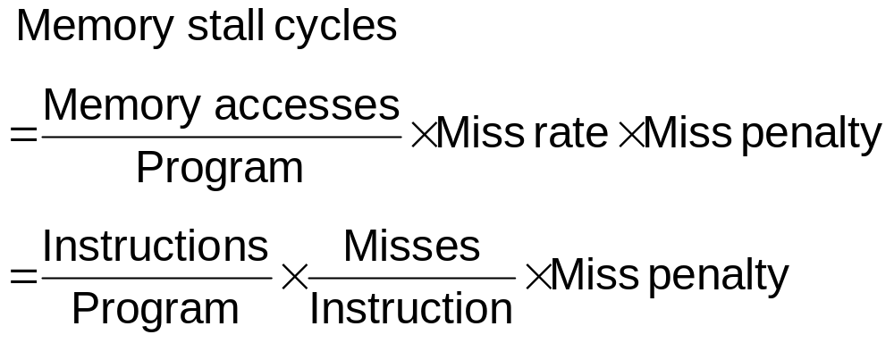
Measuring Cache Performance
Components of CPU time
  Program execution cycles
    Includes cache hit time
  Memory stall cycles
    Mainly from cache misses
With simplifying assumptions:
Memory

Slide 58
Cache Performance Example
Given
  I-cache miss rate = 2%
  D-cache miss rate = 4%
  Miss penalty = 100 cycles
  Base CPI (ideal cache) = 2
  Load & stores are 36% of instructions
Miss cycles per instruction
  I-cache: 0.02 × 100 = 2
  D-cache: 0.36 × 0.04 × 100 = 1.44
Actual CPI = 2 + 2 + 1.44 = 5.44
  Ideal CPU is 5.44/2 =2.72 times faster
Memory

Slide 59
Average Access Time
Hit time is also important for performance
Average memory access time (AMAT)
  AMAT = Hit time + Miss rate × Miss penalty
Example
  CPU with 1ns clock, hit time = 1 cycle, miss penalty = 20 cycles, I-cache miss rate = 5%
  AMAT = 1 + 0.05 × 20 = 2ns
    2 cycles per instruction
Memory

Slide 60
Performance Summary
When CPU performance increased
  Miss penalty becomes more significant
Decreasing base CPI
  Greater proportion of time spent on memory stalls
Increasing clock rate
  Memory stalls account for more CPU cycles
Can’t neglect cache behavior when evaluating system performance
Memory

Slide 61
Generalized Caching
We’ve discussed memory caching in detail
Caching in general shows up over and over in computer systems
  File system cache
  Web page cache
  Game theory databases
  Software memorization
  Others?
Big idea: if something is expensive but we want to do it repeatedly, do it once and cache the result
Memory

Slide 62
Virtual Memory
Virtual memory: memory as a cache for the disk
  Allow efficient and safe sharing of memory among multiple programs
    Compiler assigns unique virtual address space to each program
    Virtual memory maps virtual address spaces to physical spaces such that no two programs have overlapping physical address space
  Remove the programming burdens of a small, limited amount of main memory
    Allow the size of a user program exceed the size of primary memory
Virtual memory automatically manages the two levels of memory hierarchy represented by main memory and secondary storage
Memory

Slide 63
Memory vs. Secondary Storage
Analogy to cache
  Size: cache << memory << address space
  Both provide big and fast memory - exploit locality
  Both need a policy - 4 memory hierarchy questions
    Cache blocks ⇔ memory pages
    Cache misses ⇔ page faults
    Mapping between cache block number to memory address ⇔ mapping between virtual memory address to physical memory frames
Difference from cache
  Cache primarily focuses on speed
  VM facilitates transparent memory management
    Providing large address space
    Sharing, protection in multi-programming environment
Memory

Slide 64
Four Memory Hierarchy Questions
Where can a block be placed in main memory?
  OS allows block to be placed anywhere: fully associative
    No conflict misses; simpler mapping provides no advantage for software handler
Which block should be replaced?
  An approximation of LRU: true LRU too costly and adds little benefit
    A reference bit is set if a page is accessed
    The bit is shifted into a history register periodically
    When replacing, find one with smallest value in history register
What happens on a write?
  Write back: write through is prohibitively expensive
Memory

Slide 65
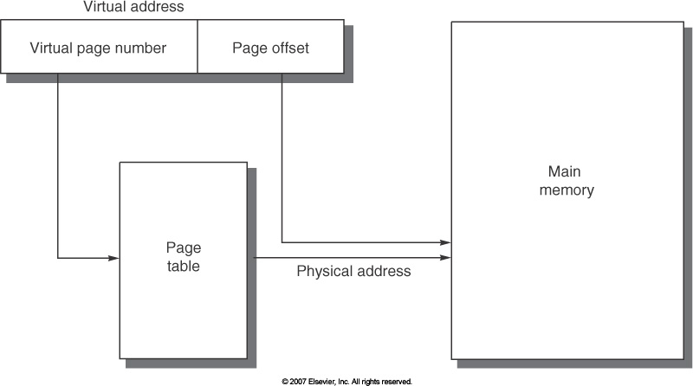
Four Memory Hierarchy Questions
How is a block found in main memory?
  Use page table to translate virtual address into physical address
  Each process has its own page table
32-bit virtual address, page size: 4KB, 4 bytes per page table entry, page table size?
(2³²/2¹²)×2²= 2²² or 4MB
Memory

Slide 66
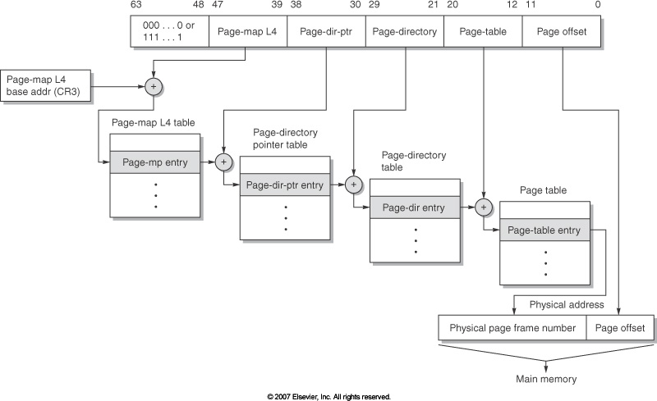
Fast Address Translation
Motivation
  Page table is too large to be stored in cache
    May even expand multiple pages itself
  Multiple page table levels
Solution: exploit locality and cache recent translations
Example: Opteron
Four page table levels
Memory

Slide 67
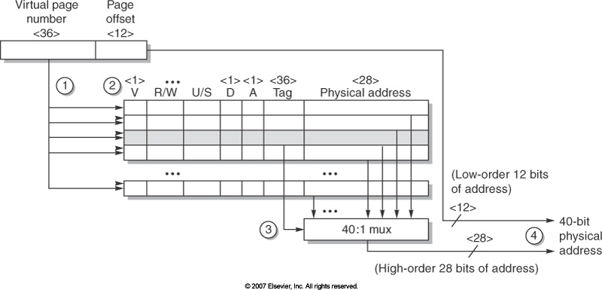
Fast Address Translation
TLB: translation look-aside buffer
  A special cache for recent translation: much fewer entries than page table
  Tag: virtual address
  Data: physical page frame number, protection field, valid bit, use bit, dirty bit
Translation
  Send virtual
  address to all tags
  Check violation
  Matching tag send
  physical address
  Combine offset to
  get full physical address
Memory

Slide 68
TLB Organization
Virtual Address Physical Address Dirty Ref Valid Access ASID
0xFA00 0x0003 Y N Y R/W 34
0xFA00 0x0003 Y N Y R/W 34
0x0040 0x0010 N Y Y R 0
0x0041 0x0011 N Y Y R 0
TLB usually organized as fully-associative cache
  Lookup is by virtual address
  Returns physical address + other info
Include protection
  Dirty => Page modified (Y/N)?
  Ref => Page touched (Y/N)?
  Valid => TLB entry valid (Y/N)?
  Access => Read? Write?
  ASID => Which user?
Memory

Slide 69
Handling Misses: Page Fault
Page fault means that page is not resident in memory
Hardware must detect the situation
  Hardware cannot rescue the situation
Therefore, hardware must trap to the operating system so that it can remedy the situation
  Pick a page to discard (possibly writing it to disk)
  Start loading the page in from disk
  Schedule some other process to run
Later (when page has come back from disk):
  Update the page table
  Resume to program so HW will retry and succeed!
Memory

Slide 70
Summary : Cache
Cache design choices:
  Size of cache: speed v. capacity
  Direct-mapped v. associative
    N-way set assoc: choice of N
  Block replacement policy
  2nd level cache
  Write through v. write back
Use performance model to pick between choices, depending on programs, technology, budget, ...
Virtual Memory
  Predates caches; each process thinks it has all the memory to itself; protection!
Memory

Slide 71
Summary: TLB, Virtual Memory
Caches, TLBs, virtual memory all understood by examining how they deal with 4 questions:
  1) Where can a block be placed?
  2) How is a block found?
  3) What block is replaced on miss?
  4) How are writes handled?
Page tables map virtual address to physical address
TLBs are a cache on translation and are extremely important for good performance
Memory
Notes:
Let’s do a short review of what you learned last time.
Virtual memory was originally invented as another level of memory hierarchy such that programers, faced with main memory much smaller than their programs, do not have to manage the loading and unloading portions of their program in and out of memory.
It was a controversial proposal at that time because very few programers believed software can manage the limited amount of memory resource as well as human.
This all changed as DRAM size grows exponentially in the last few decades.
Nowadays, the main function of virtual memory is to allow multiple processes to share the same main memory so we don’t have to swap all the non-active processes to disk.
Consequently, the most important function of virtual memory these days is to provide memory protection.
The most common technique, but we like to emphasis not the only technique, to translate virtual memory address to physical memory address is to use a page table.
TLB, or translation lookaside buffer, is one of the most popular hardware techniques to reduce address translation time.
Since TLB is so effective in reducing the address translation time, what this means is that TLB misses will have a significant negative impact on processor performance.
+3 = 3 min. (X:43)

